Slide 1
EGR-228 Final project
Cantilevered Beam

Slide 2
Agenda
Free Body Diagram
Shear and Moment Diagram
Solid Constant Beam
Hollow Constant Beam
Varied Beam
Summary

Slide 3
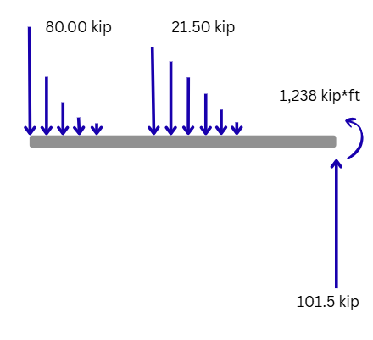
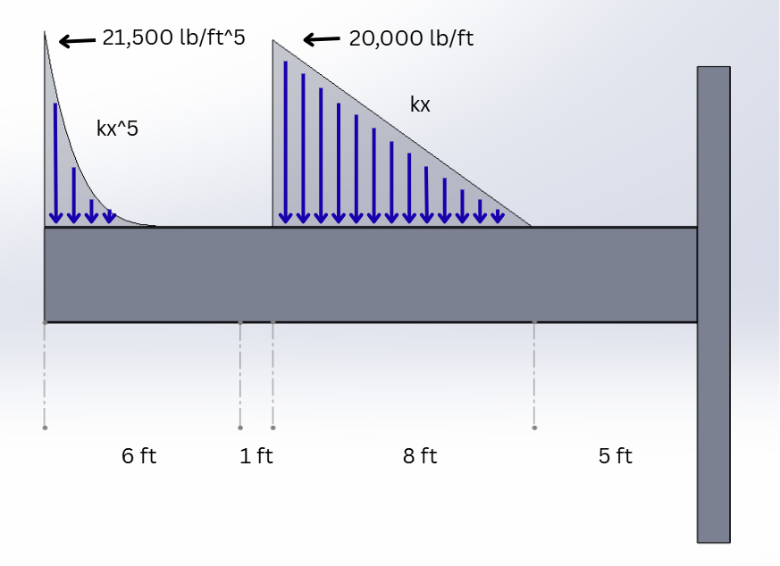
Free body diagram
Integrating the distributed forces gives the total forces, which gives the ability to find the force and moment reactions:

Slide 4
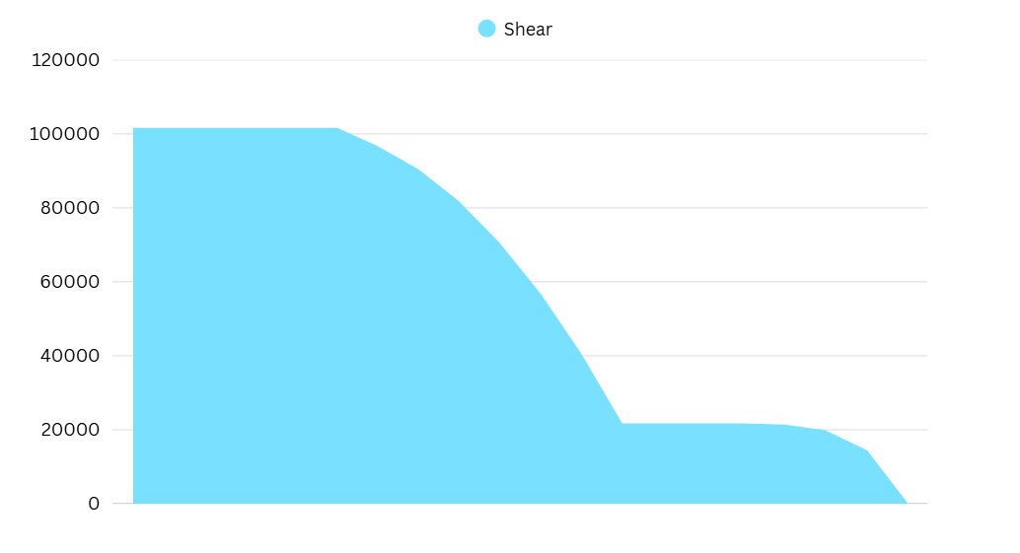
Shear diagram
Integrating the distributed forces also gives the shear force diagram when graphed.
lb
5 ft
8 ft
1 ft
6 ft

Slide 5
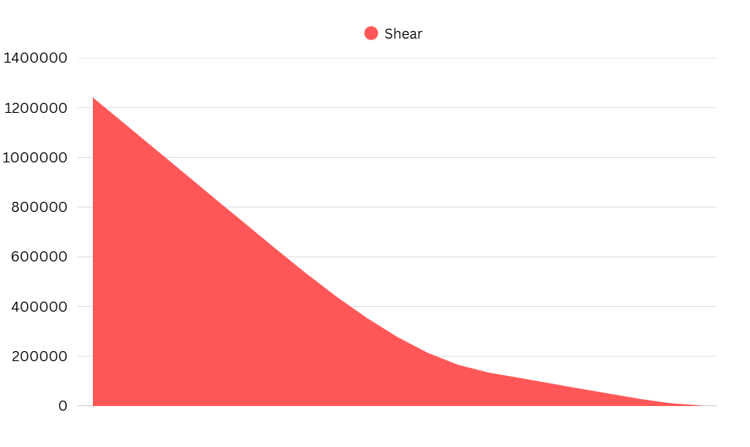
Moment diagram
Integrating the shear force diagram gives the following moment diagram.
lb*ft
5 ft
8 ft
1 ft
6 ft

Slide 6
Design considerations

Slide 7
Design requirements
The following beam will have to conform to the given requirements:
A36 Steel Construction
Factor of Safety = 4
Minimum material thickness = ½ in
Minimum beam width = 4 in
Beam cross section should be symmetric across two axes.
Given beam shape (solid constant, hollow constant, varied)
Minimize weight

Slide 8
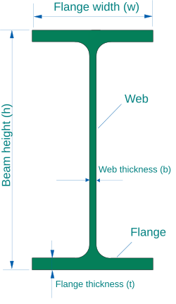
Solid constant beam shape
An I-Beam shape was selected for its efficient resistance to shear and bending forces. An I-beam is comprised of two main components:
The “web”
The “flange”
Wikipedia

Slide 9
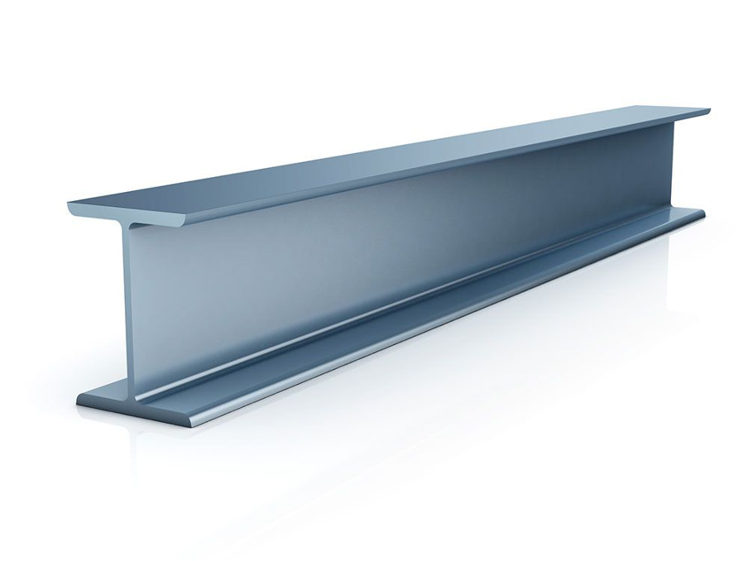
Solid constant beam shape
The “web”, or middle portion of the I-beam can handle large shear forces, while the “flange” of the I-beam can handle large bending forces. This makes I-beams an attractive tool for supporting loads, particularly in civil engineering.
Yena Engineering

Slide 10
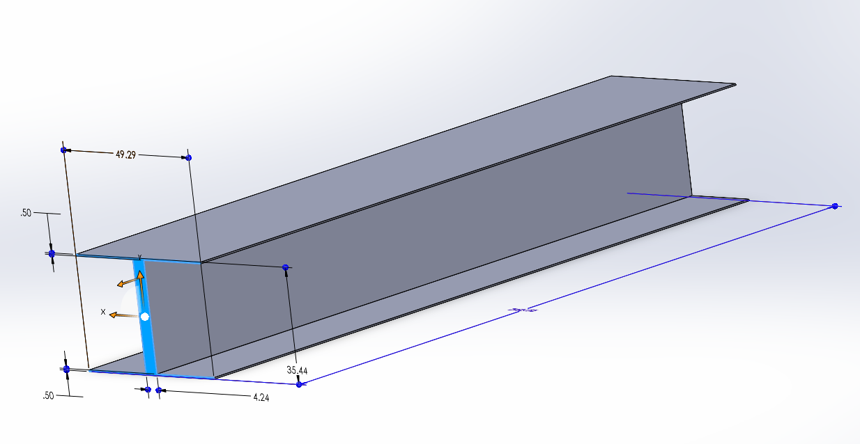
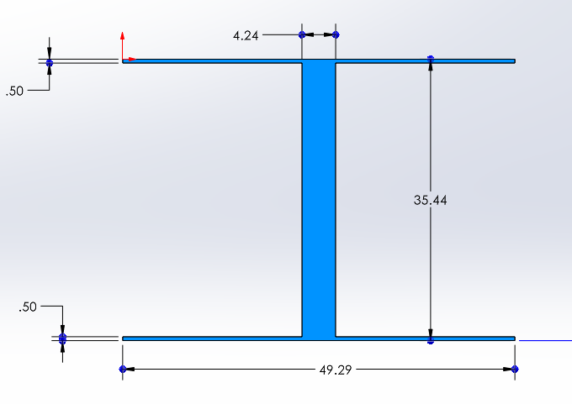
Ultimate solid-constant beam design
Height: 35.44 in
Base: 49.29 in
Flange thickness: 0.5000 in
Web thickness: 4.254 in

Slide 11




Stress calculations
The axial yield strength (36,000 psi) and shear yield strength of A36 steel (20,000 psi), as well as our designated factor of safety (4) are used to calculate the maximum stress allowed within the beam.

Slide 12



Stress calculations
The moment of inertia, section modulus, and beam area were all calculated using the following equations, respectively

Slide 13


Stress calculations
Normal stress and shear stress were calculated based off the maximum moments and shears, respectively, the beam faced. These occurred at the start of the beam, coinciding with the “wall” it was fixed to.

Slide 14
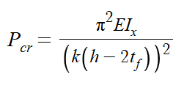
Stress calculations
Buckling was also considered as a potential source of failure, using a conservative k value of 1.0 (found in pin-pin supported beams). However, buckling was never found to be expected at any point in the beam and was not a determining factor for the shape of the beam.
A k value of 1.0 is considered a conservative estimate here, because Euler’s buckling equation would not factor the internal stresses of the flange or the stresses of the wall, which would both add rigidity to the beam and increase its critical load.

Slide 15
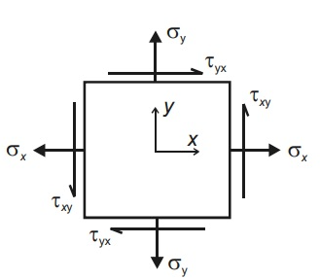



Stress calculations
Civil Engineer Online
Lastly, principal stresses were determined using the following calculations. The stress applied to the beam would only be felt in one direction, so therefore, only one normal stress value was considered.

Slide 16
optimization
Each of the dimensions of the beam (height, width, flange thickness, web thickness) can be changed, and doing so will change both the area and strength of the beam. This means that this optimization problem cannot be solved with simple algebra and instead would require guessing and checking different dimensions.

Slide 17
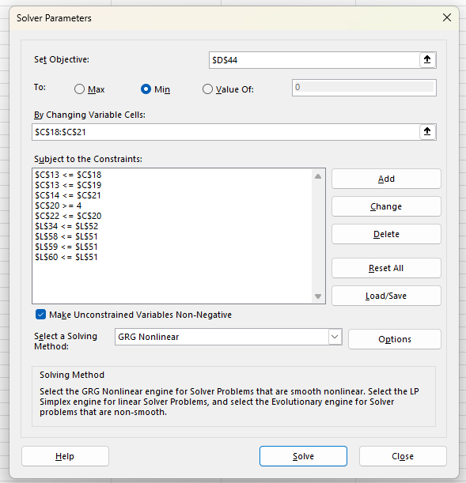
optimization
Luckily, computational tools exist which can automate this task. Microsoft Excel contains an add on which can perform these solving operations, and is what was used to determine the dimensions of the beam.
By setting objective to minimize the area of the beam, setting constraints based on the constraints of the project, and allowing the program to change the four dimensions of the beam, an optimized beam shape was found.

Slide 18
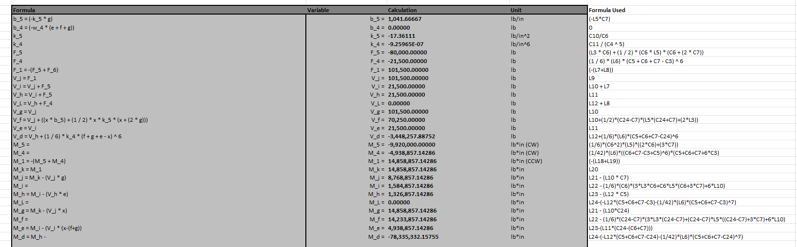
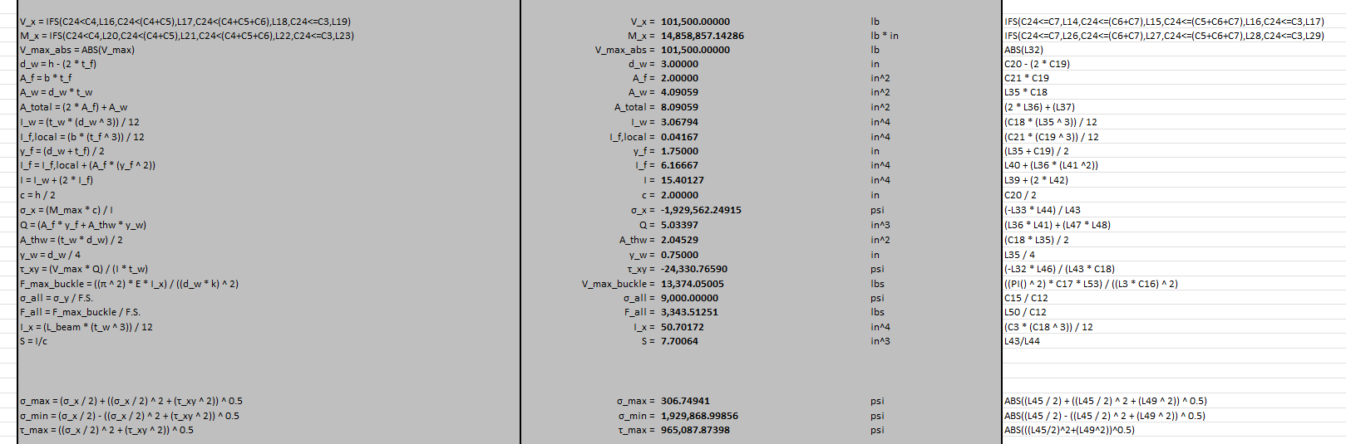
optimization
To properly automate this process, however, all proceeding necessary calculations had to also be automated. This was also done in excel, meaning the dimensions were able to be seamlessly modified while still returning accurate stress figures.

Slide 19
Solid-constant beam
Thus, the following dimensions were found for the solid constant beam:
Height: 35.44 in
Base: 49.29 in
Flange Thickness: 0.5000 in
Web Thickness: 4.254 in
Area: 195.8 in²
Section Modulus: 15,330 in³
Moment of Inertia: 271,600 in^4
Volume: 46,990 in³
Weight: 13,340 lb

Slide 20
Hollow constant beam
These simulations were unable to find a hollow constant design that was stronger than the solid constant beam already derived. If the beam’s web were to be split in two across the middle to allow for a “gap”, the normal and shear stress characteristics would stay largely the same throughout the beam, however the risk for buckling would only increase due to the thinner supporting members.
However, a hollow beam would be superior dealing with forces applied from all directions, such as those applied perpendicular to the forces applied to this beam.

Slide 21
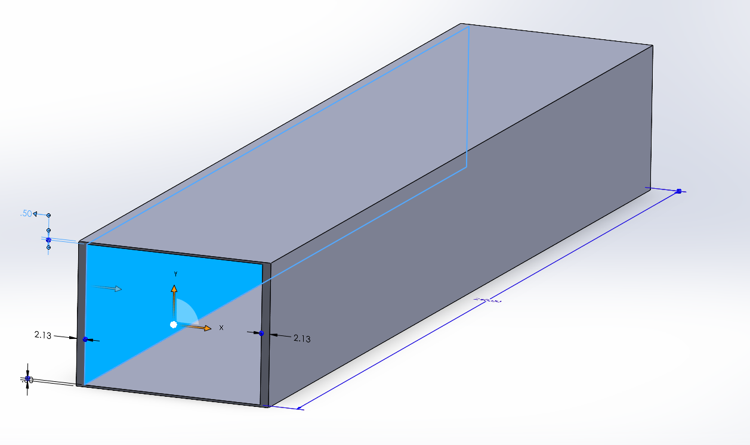
hollow-constant beam
Thus, the following dimensions were found for the solid constant beam:
Height: 35.44 in
Base: 49.29 in
Flange Thickness: 0.5000 in
Side Wall Thickness: 2.127 in
Area: 195.8 in²
Section Modulus: 15,330 in³
Moment of Inertia: 271,600 in^4
Volume: 46,990 in³
Weight: 13,340 lb

Slide 22
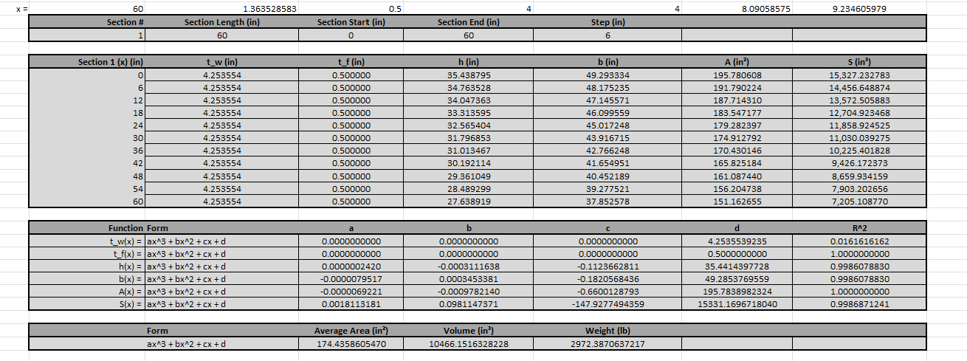
varied beam
While the Excel solver tool makes the process of finding the optimal shape of the beam much quicker, it would be impractical for one to do so for every 1-inch increment throughout the length of the beam. Therefore, a certain process was used where the properties of the beam could be approximated as a function of x.

Slide 23
varied beam
Split the beam into 5 sections.
Split each section into 10 “steps”, based on x position.
For each step in each section, run the excel solver to find the optimal shape for that given portion of the beam.
Once the dimensions for each of these steps is found, use Excel’s cubic regression function (=LINEST), to calculate an approximate formula for each dimension.
Using Excel’s R^2 calculator (=RSQ), gauge the accuracy of the formula.
This process involves the following steps:

Slide 24
varied beam
D
D
D
D
D
Using the equations for each dimension, write 5 new equations approximating the area of the beam as a function of x.
Integrate the equations of the area to find the equations for the total volume of the varied beam.
Using these equations, automation can be used to approximate every x value with any size step (x=1in was used in the spreadsheet).
This process involves the following steps:

Slide 25
varied beam
There are two reasons why sections are used, rather than splitting the entire beam into 10 steps and integrating from there.

Slide 26
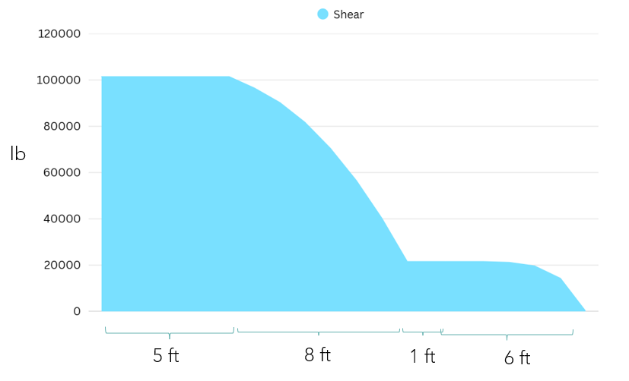
varied beam
1. As x changes throughout the beam, the load on the beam changes irregularly. This means that there will be sudden fluctuations in the optimal dimensions for the beam, rather than smooth and formulaic shear and moment trends. Each section can therefore be started at these cusps, meaning each section will have its own equation for the dimensions of its beam.

Slide 27
varied beam
2. As the dimensions change across the beam, irregular changes in the patterns of optimal beam dimensions can occur, depending largely on the constraints of the beam. For example, as the optimal width of the beam decreases to 4 inches, the minimum allowed width of the beam, the width will suddenly stop decreasing as x increases. Instead, the solver will look for other ways to reduce area, such as reducing more height or flange/web thickness. This leads to cusps in the data, which will negatively affect the accuracy of the final equations. Therefore, sections can be added at these points to retain the accuracy of the equations.

Slide 28
varied beam
Section | x (in)
1 | 0 - 60
2 | 60 - 156
3 | 156 - 168
4 | 168 - 198
5 | 198 - 240

Slide 29
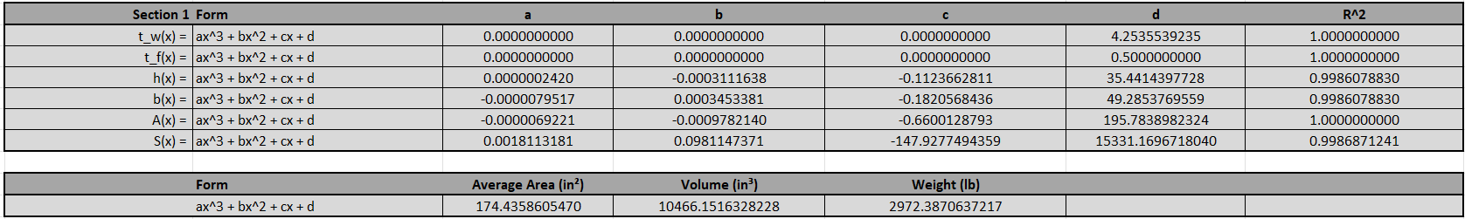
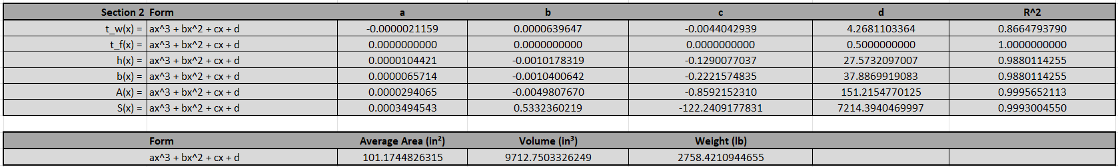
varied beam (Section 1, section 2)

Slide 30
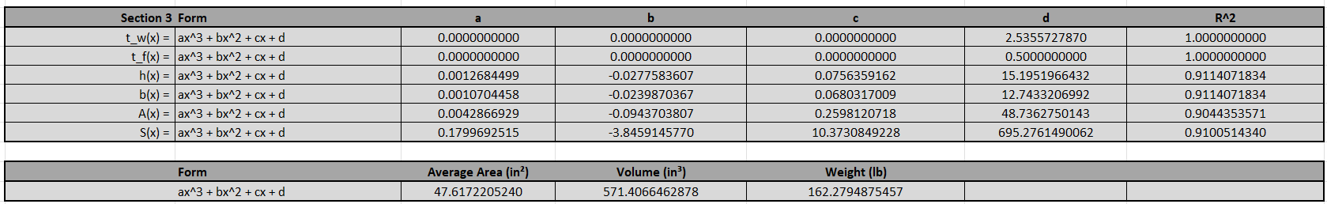
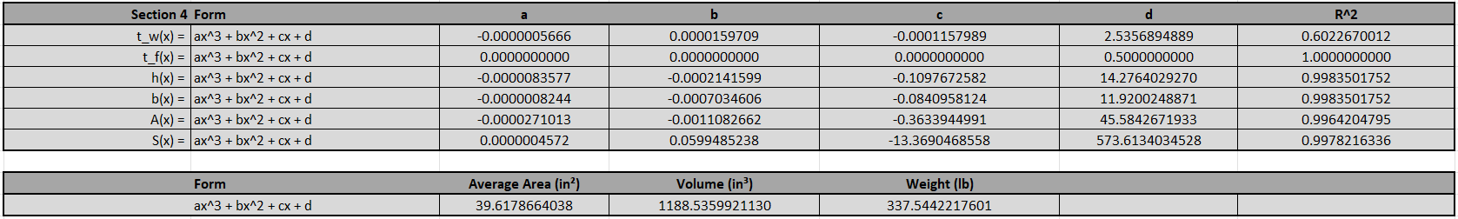
varied beam (section 3, section 4)

Slide 31
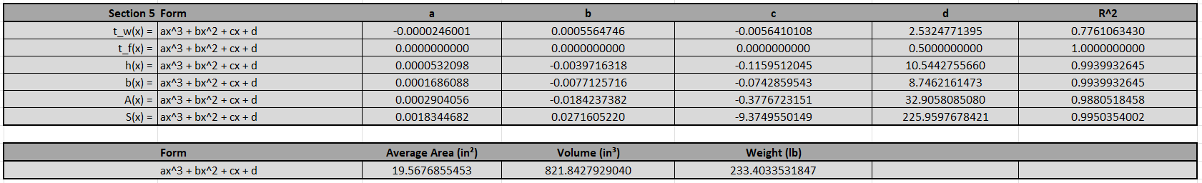
varied beam (section 5)

Slide 32
varied beam Summary
Varied Beam:
The varied beam design greatly saved on material costs compared to the constant beams, due to being able to save weight where it was not needed. In fact, the varied beam used 48.44% of the steel the constant beam did, thus being 106.4% more efficient with its steel.
Average area: 94.84 in²
Volume: 22,760 in³
Weight: 6,464 lb
Constant Beam:
Average area: 195.8 in²
Volume: 46,990 in³
Weight: 13,340 lb

Slide 33
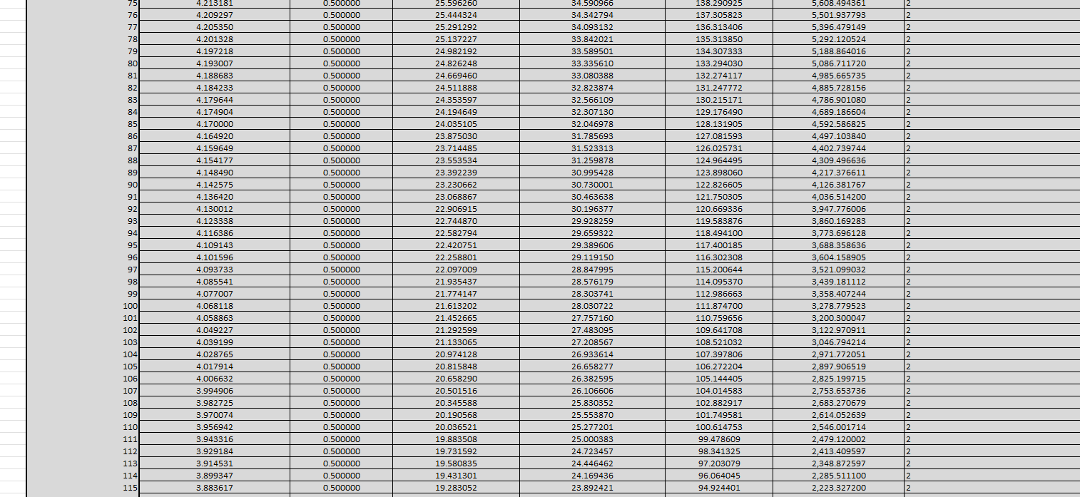
varied beam
Beam dimension table (x step = 1 in)

Slide 34
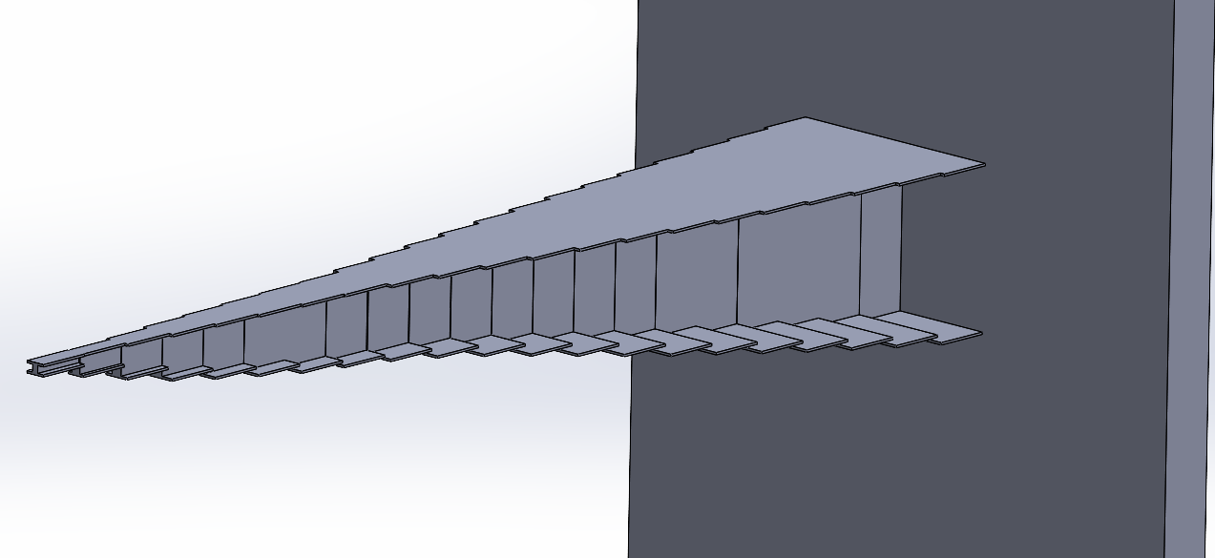
varied beam
This model serves as a visual approximation for the optimal varied beam size, with a step size of 12 in. Ideally, flanges of the beam would also connect.

Slide 35
Thank you
Aidan Crawford
EGR-228
12/11/2025

